Slide 1


Delicacies of Observability: AWS OpenSearch Cluster from 'rare' to 'well-done'
Eugene Tolbakov

Slide 2

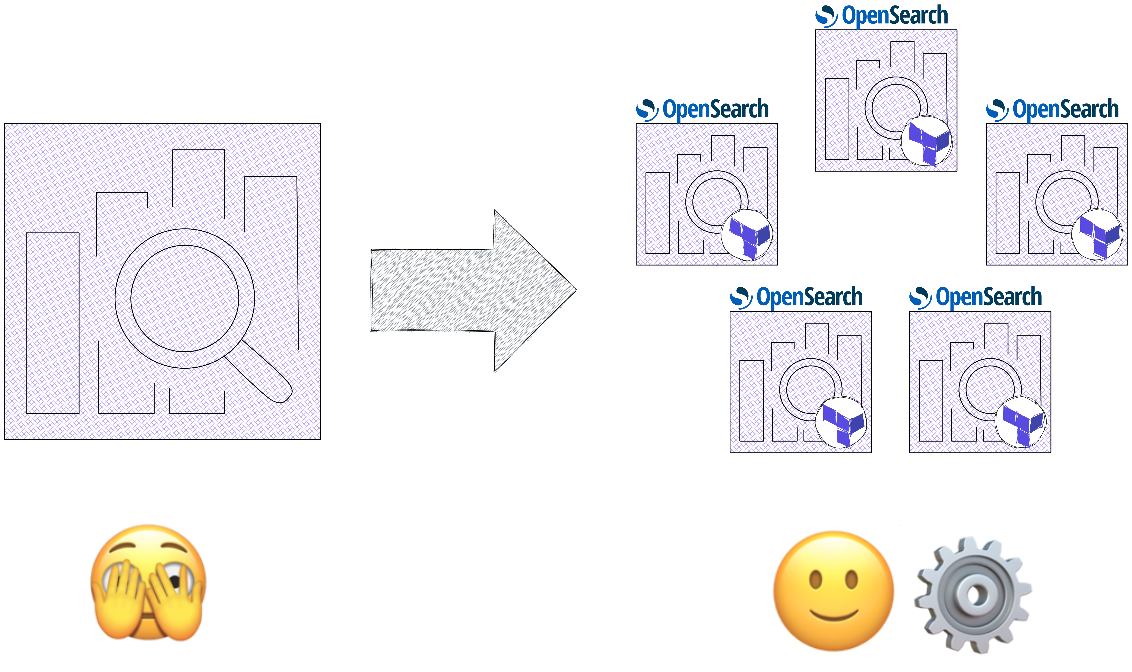



WHAT’S ON MENU
Starter:
Introduction
Main Course:
From uber – cluster to 5 log-specific clusters
IaC approach & overview of OpenSearch settings
Dessert:
Key learnings, insights & tips

Slide 3



DISCLAIMER

Slide 4
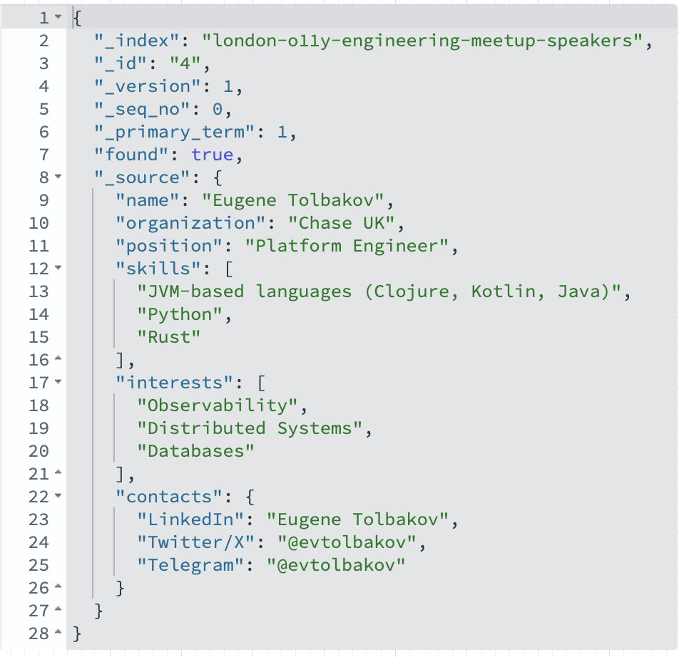


ABOUT ME
Notes:
• Chase launched in the UK in Sept 2021
• Over 2M customers (Chase and Nutmeg)
• £20B in balances (Chase and Nutmeg)
• Current accounts, savings accounts, digital wealth & investments
• Winners at the British Bank Awards in several categories*
• 4.1 Trustpilot (Chase, Sep 2023)
• 4.8 Google - 4.9 iOS App Store Ratings (Chase, Sep 2023)

Slide 5
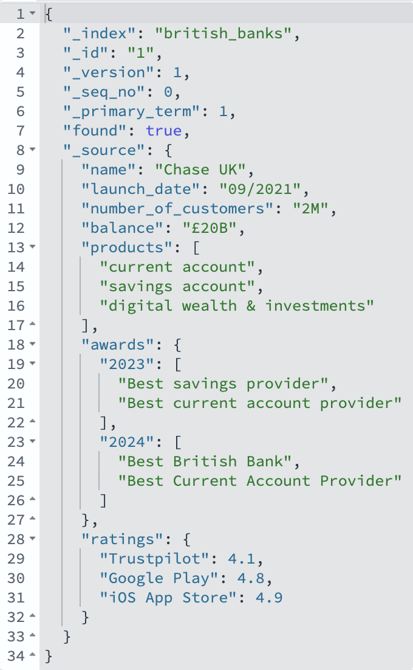


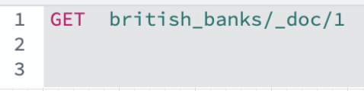

CHASE | AWARD-WINNING BANKING
Notes:
• Chase launched in the UK in Sept 2021
• Over 2M customers (Chase and Nutmeg)
• £20B in balances (Chase and Nutmeg)
• Current accounts, savings accounts, digital wealth & investments
• Winners at the British Bank Awards in several categories*
• 4.1 Trustpilot (Chase, Sep 2023)
• 4.8 Google - 4.9 iOS App Store Ratings (Chase, Sep 2023)

Slide 6


TERRAFORM 101
What? 🛠️ to define(declare) what your infrastructure looks like, instead of manually setting everything up (a.k.a. IaC)
Why? consistency, repeatability, collaboration
How? configuration files(HCL) that describes your infrastructure (VMs, storage, networking). Terraform figures out how to make those changes.
“modules” - reuse/avoid repetitive declarations
“providers” - interact with various APIs - ☁️ (AWS, etc)
- 🫙 (Mysql, Postrges) - 🤓 Spotify / Dominos - your_next_best_tool - Elasticsearch | OpenSearch

Slide 7
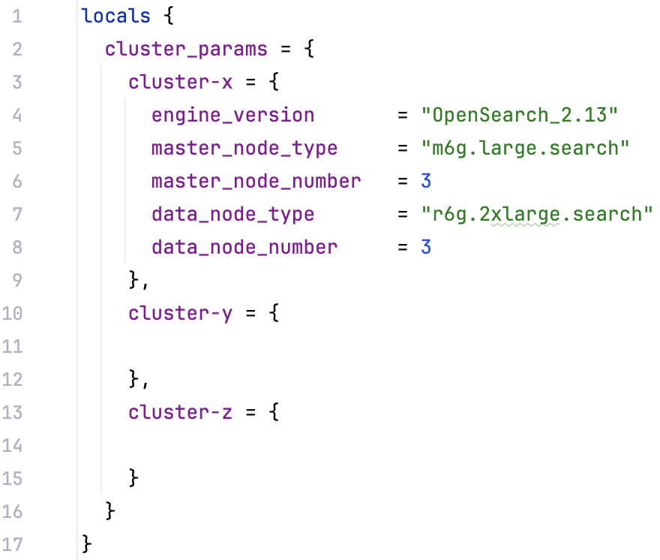
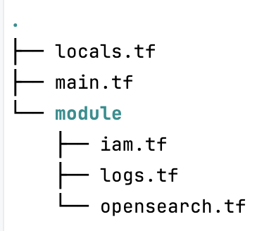
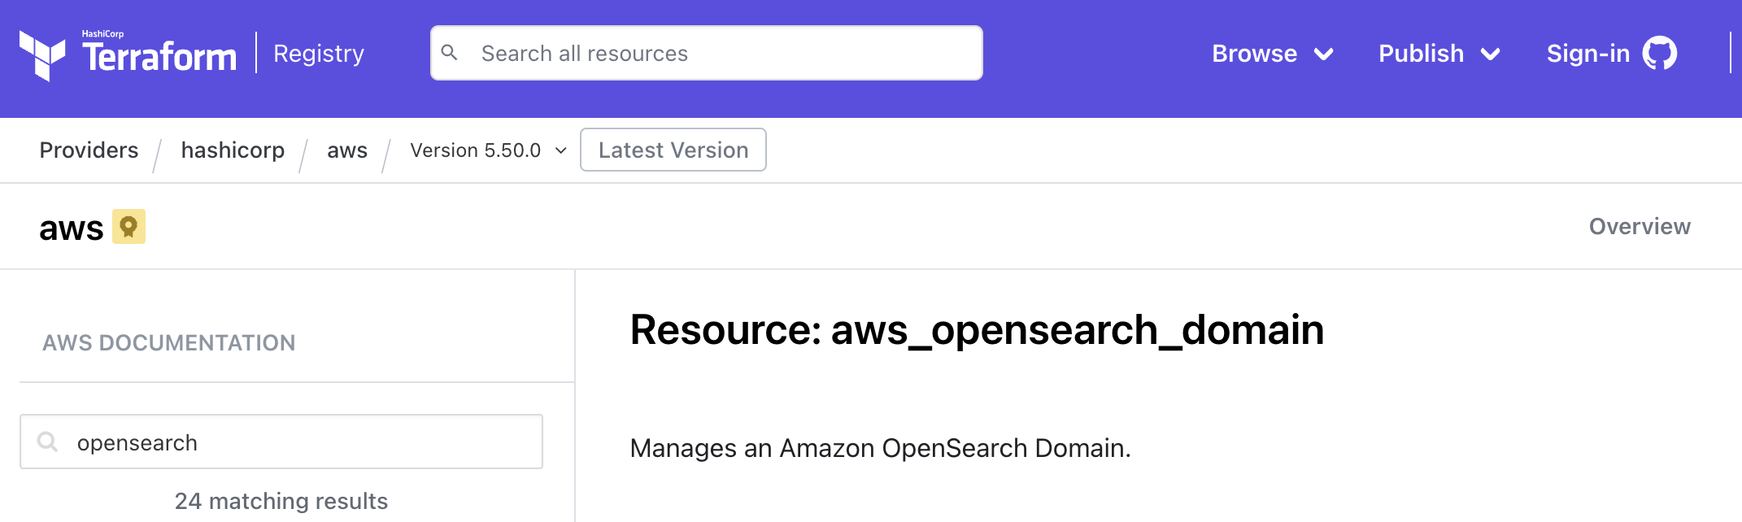
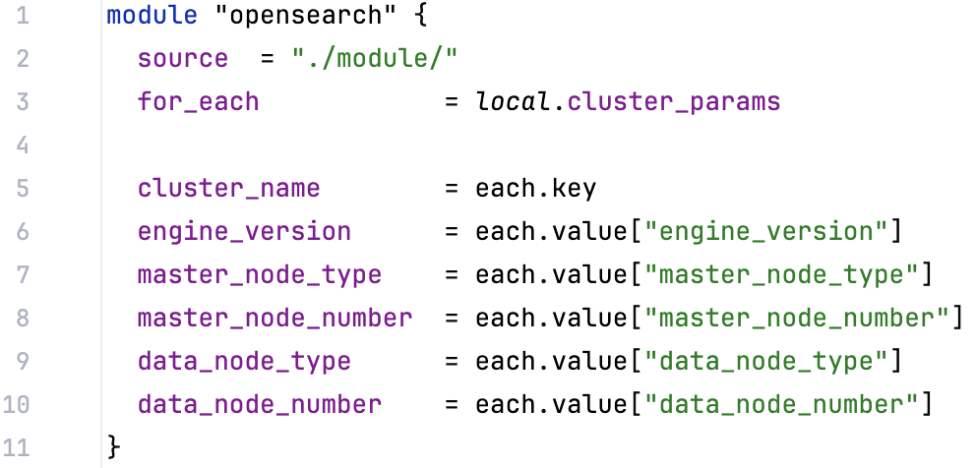

TERRAFORM 101 | AWS_OPENSEARCH_DOMAIN
11.4
11.1
11.3
11.2
Notes:
https://registry.terraform.io/providers/hashicorp/aws/latest/docs/resources/opensearch_domain
https://registry.terraform.io/providers/phillbaker/elasticsearch/latest/docs
https://registry.terraform.io/providers/opensearch-project/opensearch/latest/docs

Slide 8

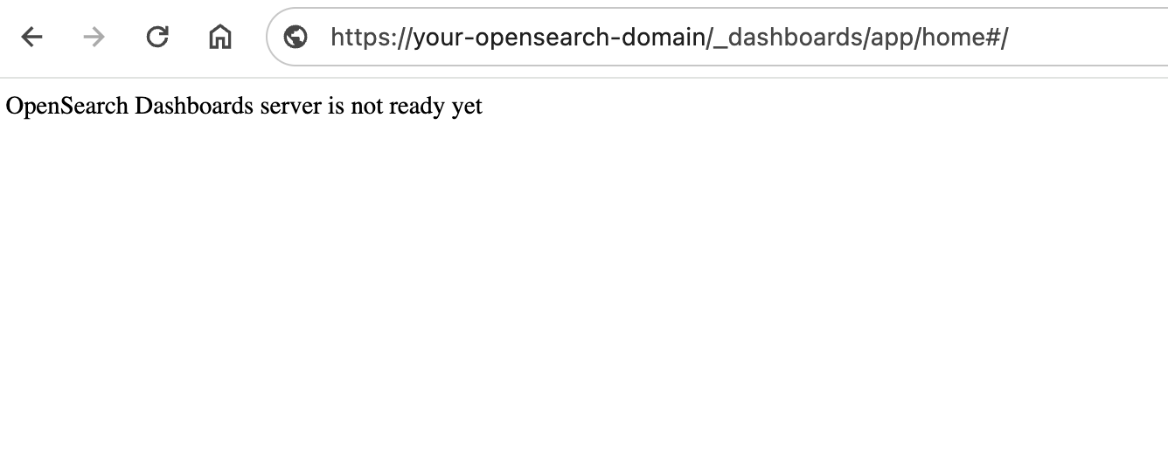
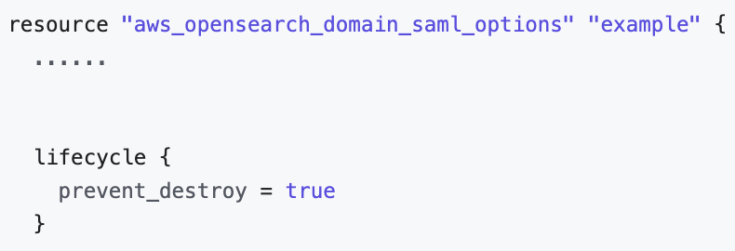
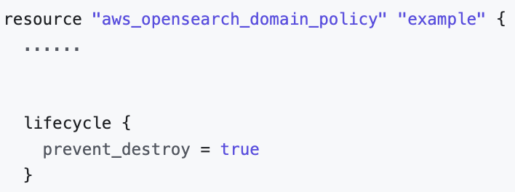
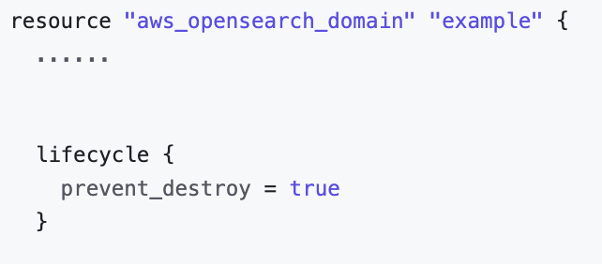

SMALLER CLUSTERS
❗️Bigger overheard
✅ Smaller cluster state
✅ More stability
✅ Smaller blast radius
Migrations 😰 (2.13 improved 👏, Workaround)
Migrations are not ”backward” 🙀
14.3
OpenSearch cluster
Cluster configuration | Data (_cat/allocation?v) | Environment
3 master nodes (r6g.xlarge.search) 24 data nodes (r6g.4xlarge.search) | 120TB 70B docs 14k shards 300 indicies / 10 index templates 2.3 - 2.4 billion entries/day | Managed cluster Multi-AZ Engine version 2.11 Indexing Data Rate : 4k/12k (avg/peak) docs/second Average Search Latency: 10ms/500ms (avg/peak)
14.1
14.4
14.2

Slide 9


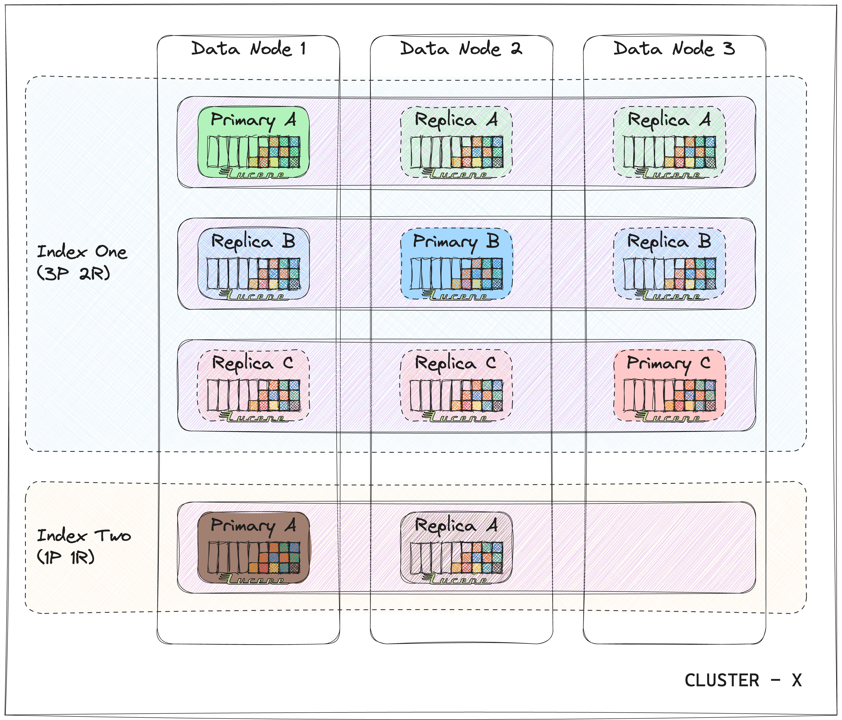
OPENSEARCH 101
Apache 2.0;
2021 Elasticsearch 🍴(version 7.10.2)
Workloads
search engine
logging
Cluster
Data node
Index
Shard
Segment
Document
22.1

Slide 10
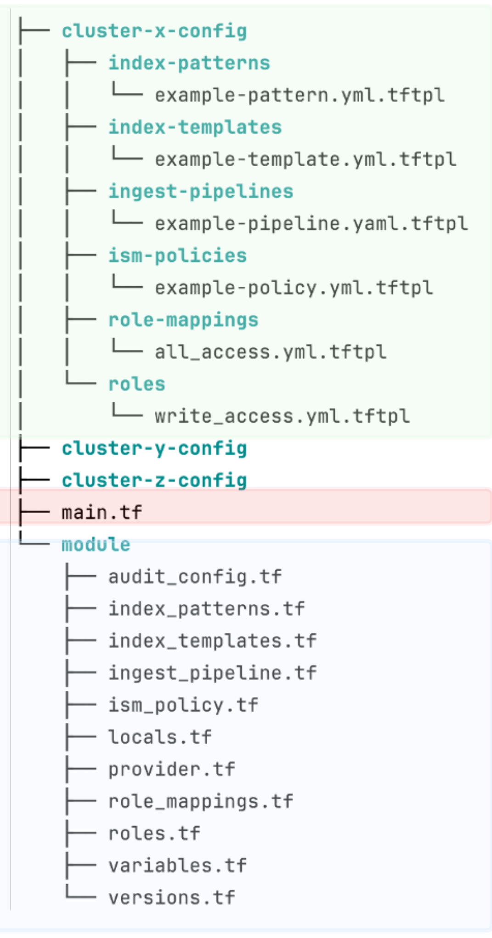
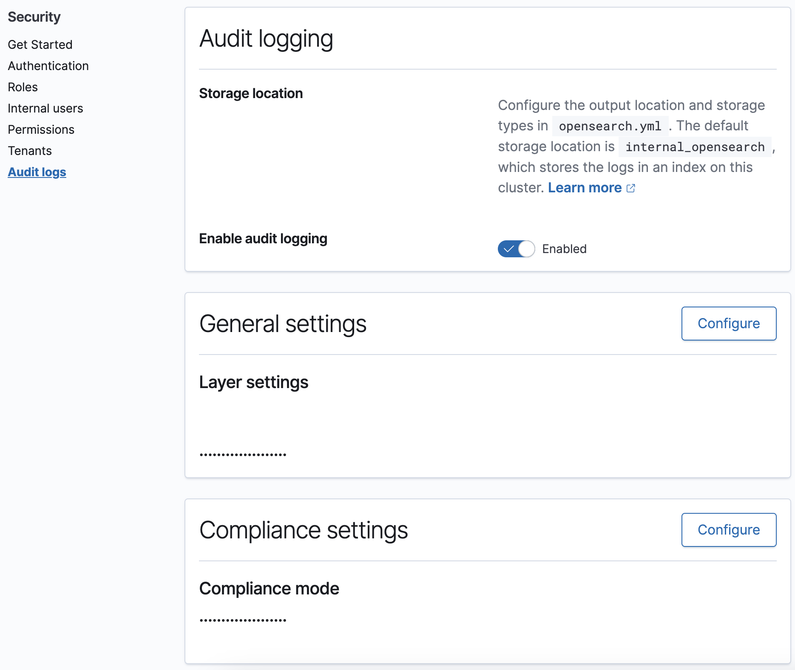
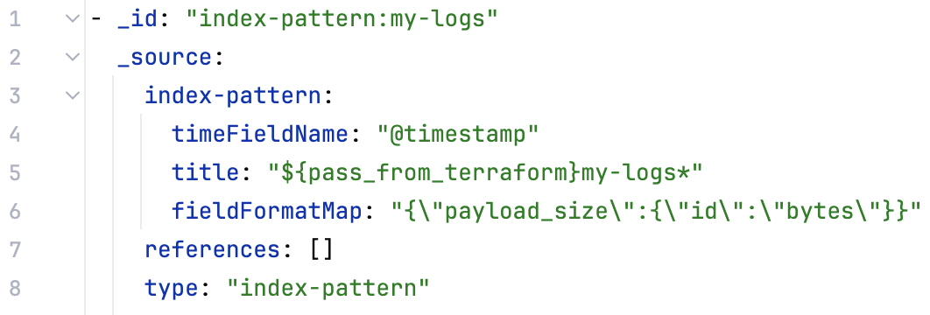
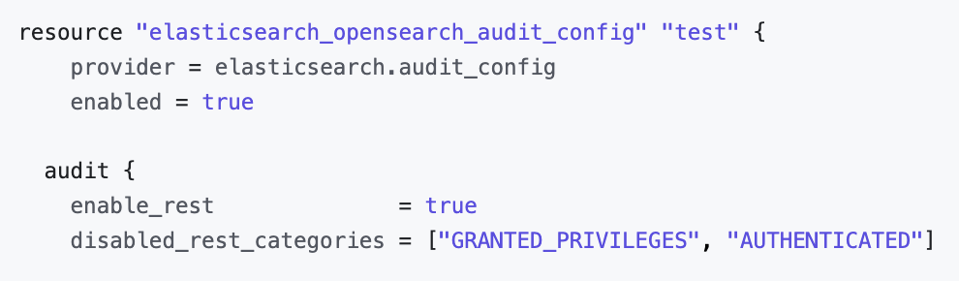
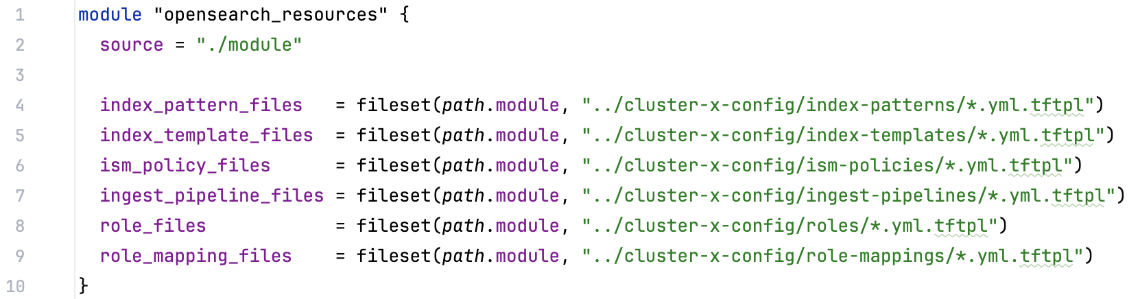
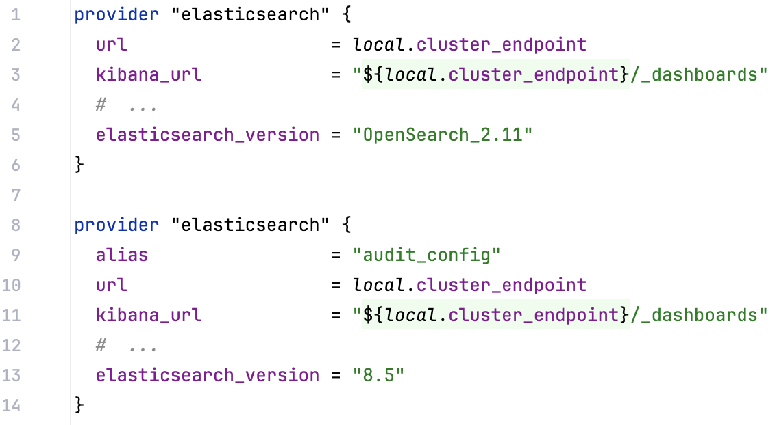
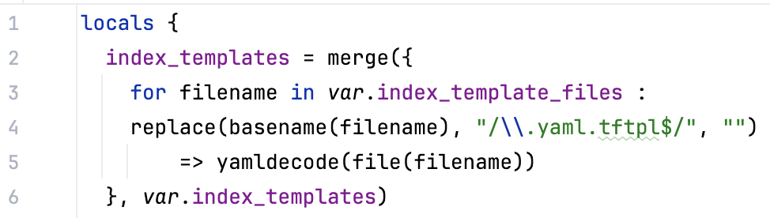
TERRAFORM 101 | OPENSEARCH RESOURCE
2 providers
.tftpl files
terraform plan
19.1
19.5
19.2
19.6
19.3
19.4
Notes:
https://registry.terraform.io/providers/hashicorp/aws/latest/docs/resources/opensearch_domain
https://registry.terraform.io/providers/phillbaker/elasticsearch/latest/docs
https://registry.terraform.io/providers/opensearch-project/opensearch/latest/docs

Slide 11
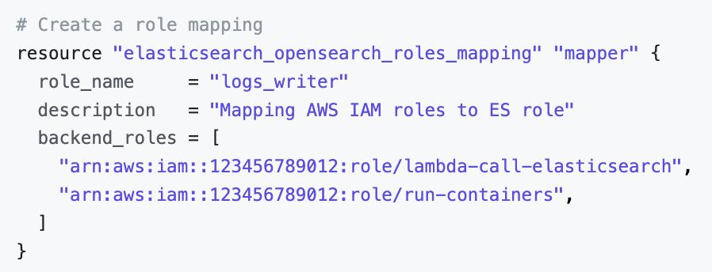
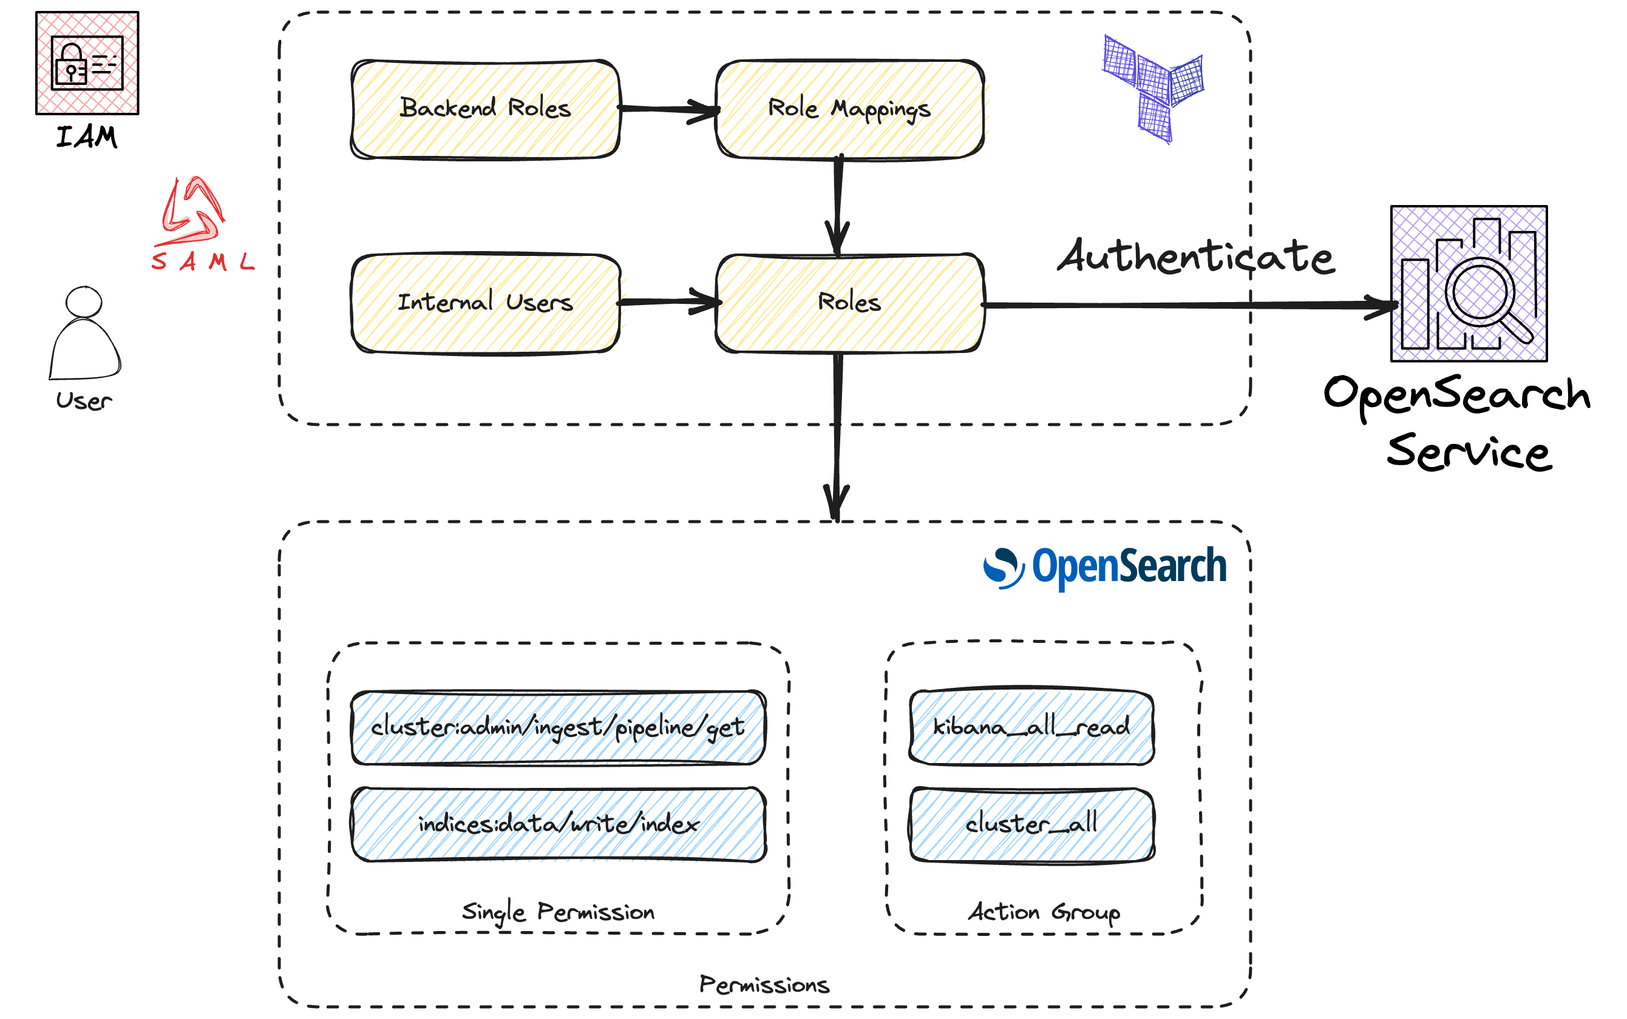
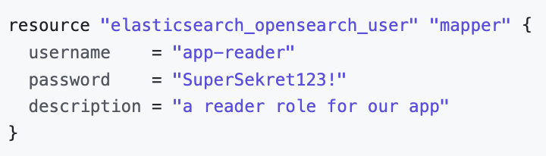
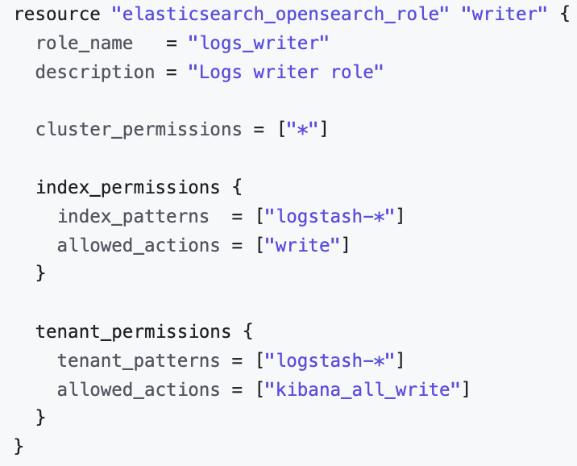
ROLES / ROLE-MAPPINGS
25.4
25.2
25.1
25.3
25.5

Slide 12

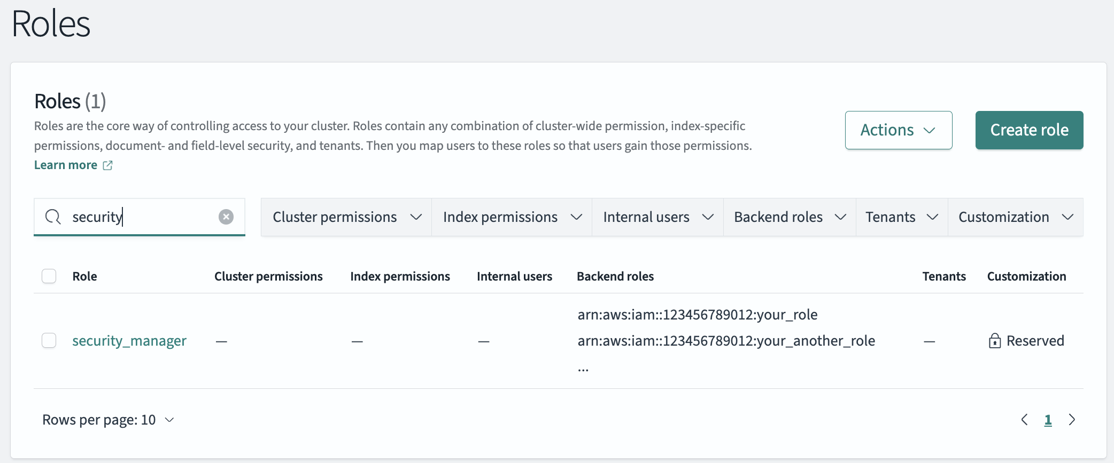
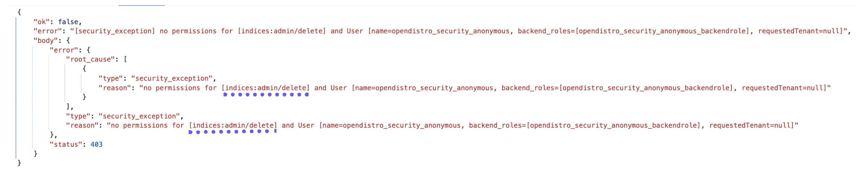
ROLES / ROLE-MAPPINGS Cont’d
field-level security 🤓
advanced settings granularity 😔
‘security_manager’ in terraform 😵
debugging 🔎
26.1
26.2

Slide 13
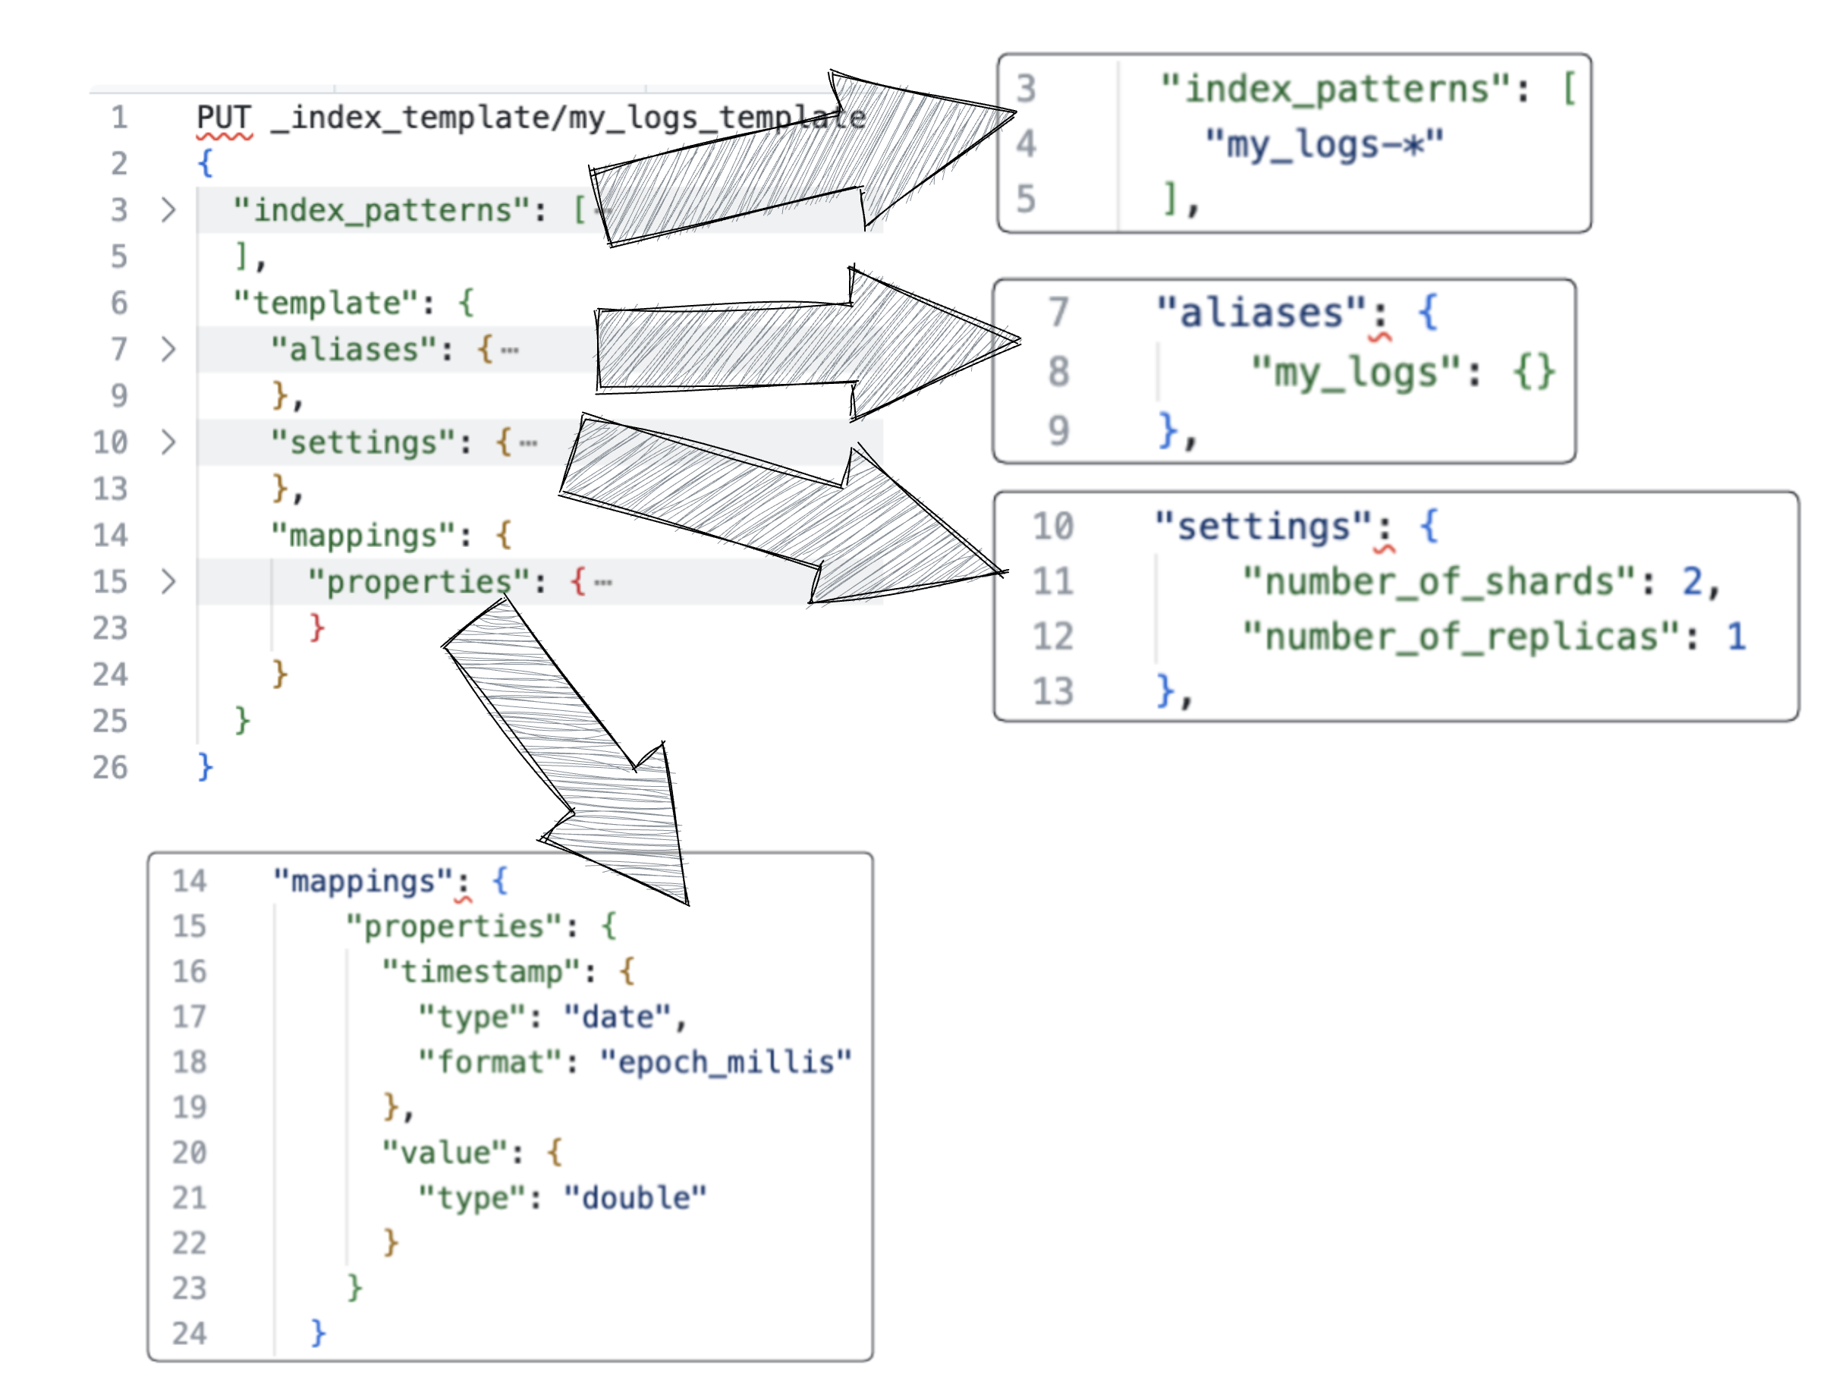
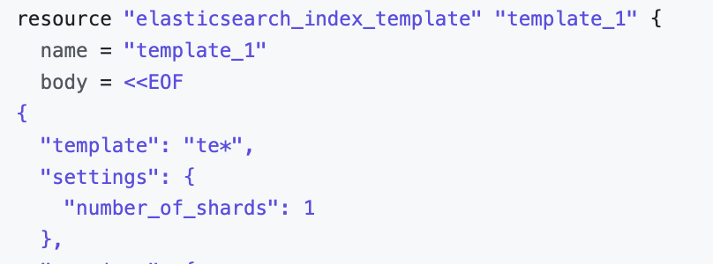
INDEX TEMPLATES
What? Blueprints for creating with predefined settings/mappings
How? Index matches a template
link indices with UI
reference to multiple indices
Why? Homogenous setting
refresh interval
pipelines
number of shards
composable / component
29.2
auto—generated IDs
@timestamp and ‘date_nanos’
‘dynamic: false | true | runtime’
’type: flat_object ‘
keyword ‘doc_values’
’type: match_only_text’ (stacktrace)
‘_size: enable=true’ / painless
29.1
Notes:
- `Mappings` — creating a schema definition. Data that is stored usually has multiple data types associated with its fields, such as `text`, `keyword`, `long`, `date`, and so on. Elasticsearch consults the mapping definitions to apply appropriate rules for analyzing incoming data before storing it for efficient and effective searching.
- `Settings` - set of configuration settings, such as number of shards and replicas, refresh rate, compression codec, and others. _Dynamic settings_ can be tweaked on a live index at runtime. _Static settings_ are applied to an index in a non-operational mode.
`Aliases` - alternate names given to indexes. An alias can point to a single or multiple indexes. For example, an alias named my_cars_aliases could point to all car indexes. We can also execute queries on aliases as if we are running them on individual aliases.
https://opster.com/guides/opensearch/opensearch-data-architecture/index-templating-in-opensearch-how-to-use-composable-templates/
https://registry.terraform.io/providers/phillbaker/elasticsearch/latest/docs/resources/index_template

Slide 14
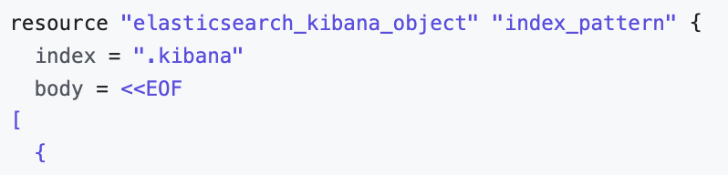
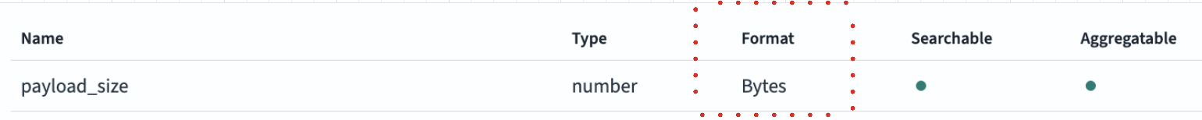
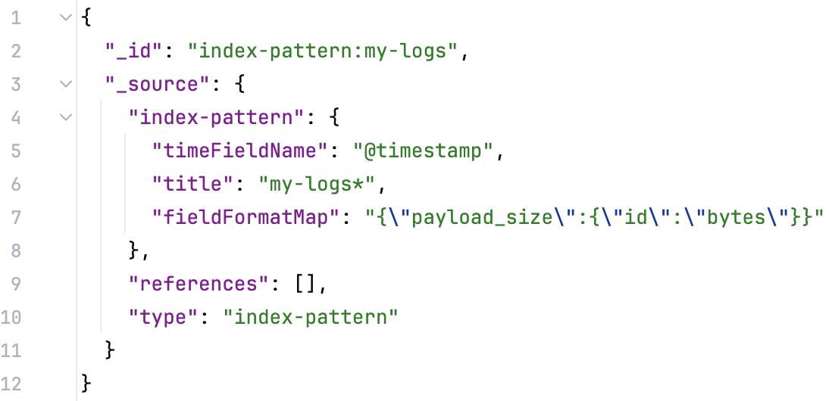
INDEX PATTERNS
‘.kibana’ index alias
refresh
Type: number / Format: Bytes
31.3
31.1
31.2
Notes:
- `Mappings` — creating a schema definition. Data that is stored usually has multiple data types associated with its fields, such as `text`, `keyword`, `long`, `date`, and so on. Elasticsearch consults the mapping definitions to apply appropriate rules for analyzing incoming data before storing it for efficient and effective searching.
- `Settings` - set of configuration settings, such as number of shards and replicas, refresh rate, compression codec, and others. _Dynamic settings_ can be tweaked on a live index at runtime. _Static settings_ are applied to an index in a non-operational mode.
- `Aliases` - alternate names given to indexes. An alias can point to a single or multiple indexes. For example, an alias named my_cars_aliases could point to all car indexes. We can also execute queries on aliases as if we are running them on individual aliases.
https://opensearch.org/docs/latest/field-types/supported-field-types/match-only-text/

Slide 15
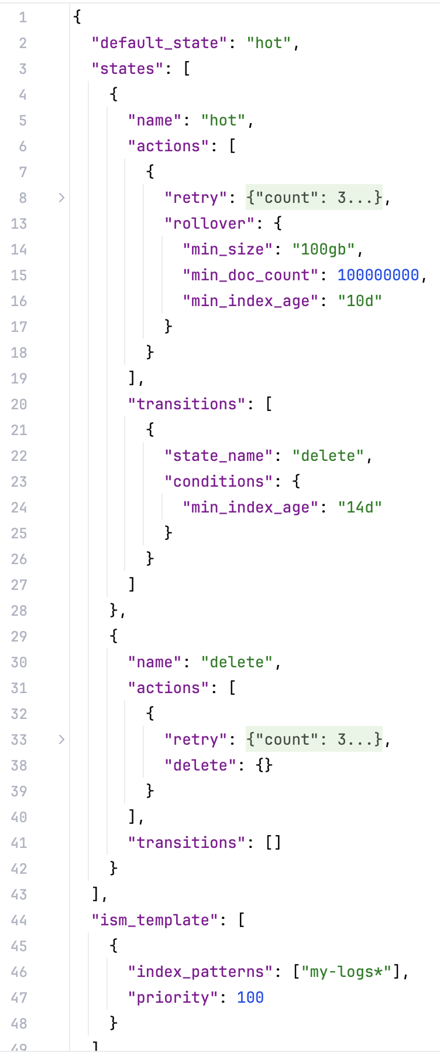
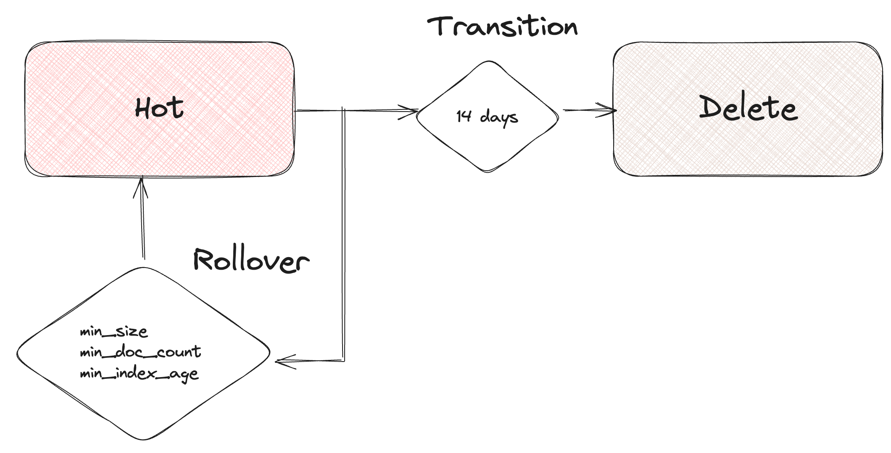
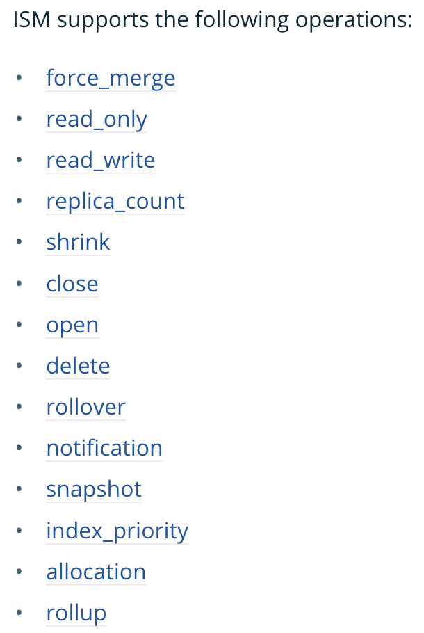
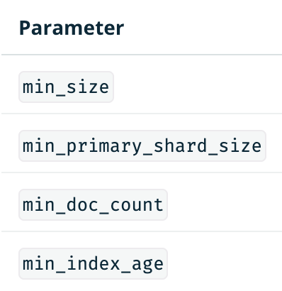
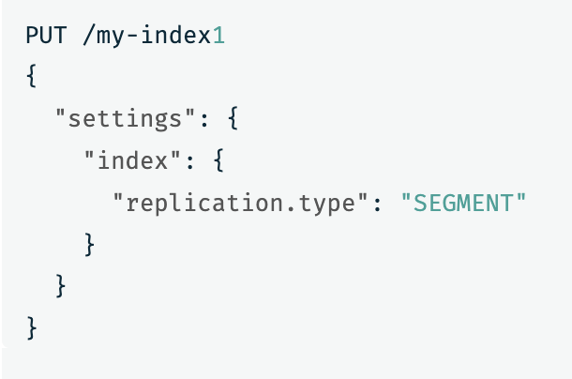
ISM / ILM POLICIES
Hot – fastest/costly
(im4g/MRC-6g instances)
UltraWarm (HDD)
Cold (S3)
Mixed Hot/Warm
(OR1 instances*)
33.3
Look after the rollover
33.2
33.1
33.4
33.5
Notes:
https://opensearch.org/docs/2.14/im-plugin/ism/policies/#rollover
https://opensearch.org/docs/2.14/im-plugin/ism/policies/#transitions
https://opensearch.org/docs/latest/tuning-your-cluster/availability-and-recovery/segment-replication/index/
https://docs.aws.amazon.com/opensearch-service/latest/developerguide/ism.html#ism-diff
https://docs.aws.amazon.com/opensearch-service/latest/developerguide/ism-tutorial.html

Slide 16
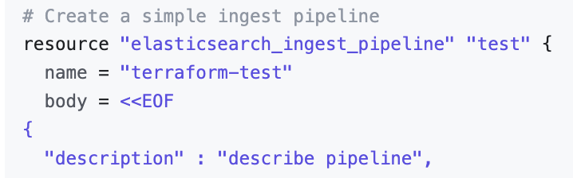
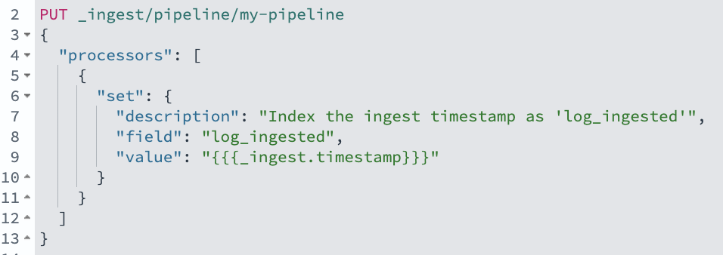
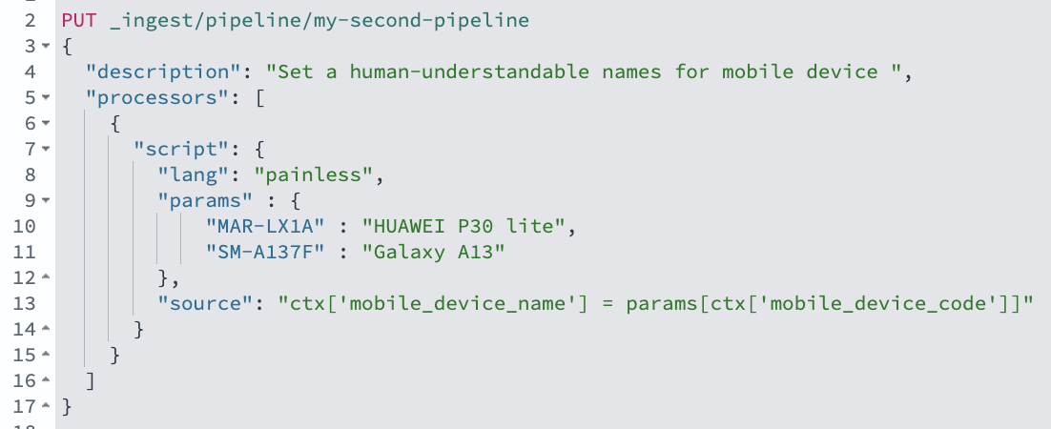
INGEST PIPELINES
Enrichment 💰
35.1
35.2
35.3
Notes:
Data Cleaning: Removing unwanted fields, fixing data inconsistencies, and converting data types.
Data Enrichment: Adding additional information to documents based on pre-defined rules or external sources.
Data anonymization: Obscuring sensitive data before storing it in OpenSearch
https://www.elastic.co/guide/en/elasticsearch/reference/8.13/ingest.html#template-snippets
https://registry.terraform.io/providers/phillbaker/elasticsearch/latest/docs/resources/ingest_pipeline

Slide 17
DESSERT | CHECKLIST | BEST PRACTICES
prefer smaller clusters (<30k shards)
lifecycle {prevent_destroy = true }
use _bulk API for ingestion
extra care with ‘security_manager’ role
use index templates
define settings (number of shards)
define mappings
auto—generated IDs
@timestamp and ‘date_nanos’
‘dynamic: false’
’type: flat_object ‘
keyword ‘doc_values’
’type: match_only_text’
extra care with ILM (avoid oversharding)

